Slide 1
Symphony of the Scriptures
Galatians

Slide 2
Galatians
55-57
A.D.
Personal Words from Paul
Doctrinal Teaching
Practical Exhortations
“Be not deceived; God is not mocked: for whatsoever a man soweth, that shall
he also reap” 6:7)
Defense of the
True Gospel
Freedom from
Legalism
Freedom to Love
and to Serve
“For I would have you know, brethren,
that the gospel which was preached by
me this is not according to man. For
by me is not according to man. For I
neither received it from man, nor was
I taught it, but I received it through a
revelation of Jesus Christ.” (1:11-12)
“Therefore the Law has be-
come our tutor to lead us to
Christ, so that we may be
justified by faith. But now
that faith has come, we are no longer under a tutor.”
(3:24-25)
“For you were called to
freedom; only do not turn
your freedom into an
opportunity for the flesh.
but through love serve
one another.” (5:13)
Chapters 1-2
Chapters 3-4
Chapter 5-6
Style
Vigorous, blunt, direct and brief…correct Judaizing teachers (see Acts 15:1)
Theme
Justification comes through Christ Jesus, not by works of the Law
“Nevertheless, knowing that man is not justified by the works of the Law but through faith in Christ Jesus, even we have believed in Christ Jesus, so that we may be justified by faith in Christ and not by the works of the Law, since by the works of the Law no flesh will be justified.” (2:16)
Key Verse
Notes:
Galatians has always been among those Pauline epistles least challenged on the issue of authorship. Paul wrote to the churches in southern Galatia after having a hand in starting them on his first missionary journey to Asia Minor. These churches included Antioch of Pisidia, Iconium, Lystra and Derbe (Acts 14:1-28). The letter was written in about A.D. 57, about 12 years after these churches had been established. Paul’s close relationship to these churches helps to explain the extremely strong tone he took with them from the very beginning of the letter. Galatians exhibits Paul at his angriest, ”astonished that you are so quickly deserting him who called you in the grace of Christ and are turning to a different gospel” (1:6). In fact, to emphasize the seriousness of his purpose, he took the pen from his scribe and wrote the end of the letter himself in “large letters” (6:11 leading many to conclude that Paul had impaired vision. Upon arriving back in Antioch from his first missionary journey after eighteen months on the road, Paul received a report that the churches he had started in Galatia had fallen into hard times—specifically, they had fallen into error. Apparently, a group of Judaizers—those who sought to make a living under the Mosaic Law a requirement of the Christian faith—had gained an influence in the Galatian churches. More specifically, they were making circumcision a necessity for all Gentile coverts (5:2-6).. We recall that Paul had earlier been in attendance at the Jerusalem Council where the apostles would take up this very topic (Acts 15:1–30). It was not new. Paul had clearly taught the Galatians that “as many as were baptized into Christ” had been made “sons of God” --- be it Jew or Greek, male or female (3:26-27). How could it be that they so soon had forgotten his instruction? Paul’s rebuke is straightforward (1:6-8). The theme is clearly justification by faith in Christ Jesus (3:26-29). No one can keep the Law perfectly. That said, we must walk a fine line—on one hand, we do not want to fall into the legalism that the Galatians struggled with, but on the other hand, we cannot just live as if anything goes. Obedience matters. The Christian’s commitment to Christ is based on the free gift of grace through faith, but as Paul articulated at the end of Galatians, it also results in a life of walking by the Spirit (Gal. 16:1ff.). Paul reminds us, “Be not deceived; God is not mocked: for whatsoever a man soweth, that shall he also reap” (6:7). The letter can be divided into three parts: Paul is an apostle through Jesus Christ and not after man (chs. 1-2); justification is by faith in Christ Jesus and not by the words of the Law of Moses (chs. 3-4); exhortations to steadfastness and faithfulness to all Christians (chs. 5-6).
Application
Preachers beware! Preaching is not intended to please men: “For am I now seeking the approval of man, or of God?” (1:10)
Error must be exposed immediately: “But when Cephas came to Antioch, I opposed him to his face” (2:11).
Peter feared the wrong thing: “but when they came he drew back and separated himself (from Gentiles), fearing the circumcision party” (2:12b). We must not make men bigger than God.
The Law serves as a tutor (schoolmaster) to bring us unto Christ - its purpose was to show the need of a Savior (3:23-25).
The Spirit is in us when we walk by the Spirit (5:25); The flesh and the Spirit are contrary to one another.
Key thought: The word “Fruit” is singular. The character of godliness includes all the characteristics of the fruit of the Spirit. As darkness is the opposite of light, so are the works of the flesh the opposite of the works of the Spirit. It is a demonstration of character.

Slide 3
Period | History Covered | Scriptures | Years | Principal
Antediluvian | Creation to the Flood | Gen. 1-7 | 1656 | Adam
Postdiluvian | From the flood to call of Abraham | Gen. 8-!1 | 427 | Noah
Patriarchal | From the call of Abraham to Egyptian Bondage | Gen. 12-45 | 215 | Abraham
Egyptian Bondage | From Egyptian Bondage to the Exodus | Gen. 46-Ex. 11 | 215 | Joseph
Wilderness Wanderings | From Exodus to crossing of the Jordan | Ex. 12-Deut. 34 | 40 | Moses
Conquest of Canaan | From crossing of Jordan to Joshua’s death | Josh. 1-24 | 51 | Joshua
Judges | From Joshua to King Saul | Ju, Ruth, 1 Sa. 1-9 | 305 | Samuel
The United Kingdom | From origin of kingdom to its division | 1 Sa. 9-1 Ki. 11; 1 Chr. 10, 2 Chr. 9 | 120 | David
The Divided Kingdom | From the division to the fall of Israel | 1 Ki. 12-2 Ki. 20; 2 Chr. 10-32 | 253 | Elijah
Judah Alone | From fall of Israel to the fall of Judah | 2 Ki. 21-25; 2 Chr. 10-32 | 125 | Josiah
Babylonian Captivity | From the fall of Judah to the return | 2 Ki. 25-8- 21; Dan. 1-6; Ezekiel | 70 | Daniel, Ezekiel
Restoration of the Jews | From the return to end of OT history | Ezra, Nehemiah | 92 | Ezra
Between the Testaments | From end of OT to the beginning of the NT | None | 400 | Judas Maccabee
Life of Christ | From birth of Jesus to ascension | Mt-Jhn 21; Acts1 | 34 | Jesus
The Church | From ascension to death of John (98 AD approx.) | Acts 2-Revelation | 70 | Paul

Slide 4
Matthew
Mark
Luke
John
Acts
Romans
1 Corinthians
2 Corinthians
Galatians
Ephesians
Philippians
Colossians
1 Thessalonians
2 Thessalonians
1 Timothy
2 Timothy
Titus
Philemon
Hebrews
James
1 Peter
2 Peter
1 John
2 John
3 John
Jude
Revelation
CHRONOLOGICAL
James 50 AD
Mark 50 AD
1 Thessalonians 52 AD
2 Thessalonians 52 AD
1 Corinthians 57 AD
2 Corinthians 57 AD
Galatians 58 AD
Romans 58 AD
Matthew 58 AD
Luke 58 AD
Acts 62 AD
Philippians 62 AD
Philemon 62 AD
Colossians 62 AD
Ephesians 62 AD
1 Peter 65 AD
2 Peter 67 AD
Jude 67 AD
Titus 67 AD
1 Timothy 67 AD
2 Timothy 68 AD
Hebrews 69 AD
John (Gospel) 85 AD
1 John 85 AD
2 John 85 AD
3 John 85 AD
Revelation 95 AD
CANON
*From Hester, Heart of NT History

Slide 5
About the New Testament “Canon”
The list of books which are recognized as inspired and authoritative.
FIVE DIVISIONS
Gospels (4)
Matthew
Mark
Luke
John
Acts (1)
Book of History
Letters of Paul (13)
Thessalonians (2)
Corinthians (2)
Romans
Galatians
Philippians
Philemon
Ephesians
Colossians
Timothy (2)
Titus
General Letters (8)
James
1 & 2 Peter
1,2, 3 John
Jude
Hebrews
Apocalyptic (1)
Revelation

Slide 6
Two Theories: North and South Galatian Theory
“Was it to the ethnic Galatians of the north that Paul wrote his Galatian letter, or did he address it to more extensive Roman province of Galatia (south) ?”
--- Jack Mckinney, Truth for Today Commentary, Galatians, page 3-5.
North Galatian Theory - a view held by most German theologians and more liberal scholars. This is called “ethnic Galatia” and includes three principal cities in the area of north-central Asia Minor; including, Pessinus, Tavium, and Ancyra (modern Ankara). The later became the capital of Galatia. This area had been settled in about 230 B.C. by Gallic tribes from the Roman province of Gaul (modern France).
South Galatian Theory - Being a more conservative view, and generally held by British and American scholars, it holds that the Galatian letter was written to churches that Luke named in Acts. These were churches Paul established during the first missionary journey (Acts chapters 13 & 14). Specifically, they would include Antioch, Iconium, Lystra, and Derbe, all of which were in the southern part of the Roman province of Galatia.
Since there is no mention of the northern cities in Scripture, and no evidence to support that Paul and his coworkers ever visited there, we assume the South Galatian Theory to be most probable.

Slide 7
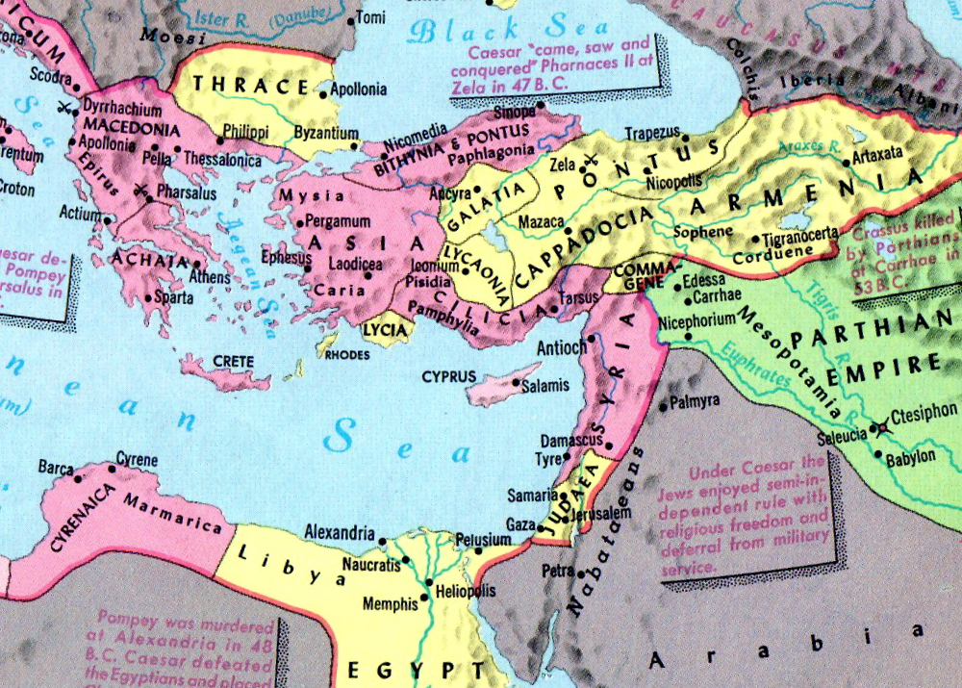
Eastern Mediterranean Area in 40 BC

Slide 8
Two Theories: North and South Galatian Theory
“Was it to the ethnic Galatians of the north that Paul wrote his Galatian letter, or did he address it to more extensive Roman province of Galatia (south) ?”
--- Jack Mckinney, Truth for Today Commentary, Galatians, page 3-5.
North Galatian Theory - a view held by most German theologians and more liberal scholars. This is called “ethnic Galatia” and includes three principal cities in the area of north-central Asia Minor; including, Pessinus, Tavium, and Ancyra (modern Ankara). The later became the capital of Galatia. This area had been settled in about 230 B.C. by Gallic tribes from the Roman province of Gaul (modern France).
South Galatian Theory - Being a more conservative view, and generally held by British and American scholars, it holds that the Galatian letter was written to churches that Luke named in Acts. These were churches Paul established during the first missionary journey (Acts chapters 13 & 14). Specifically, they would include Antioch, Iconium, Lystra, and Derbe, all of which were in the southern part of the Roman province of Galatia.
Since there is no mention of the northern cities in Scripture, and no evidence to support that Paul and his coworkers ever visited there, we assume the South Galatian Theory to be most probable.

Slide 9
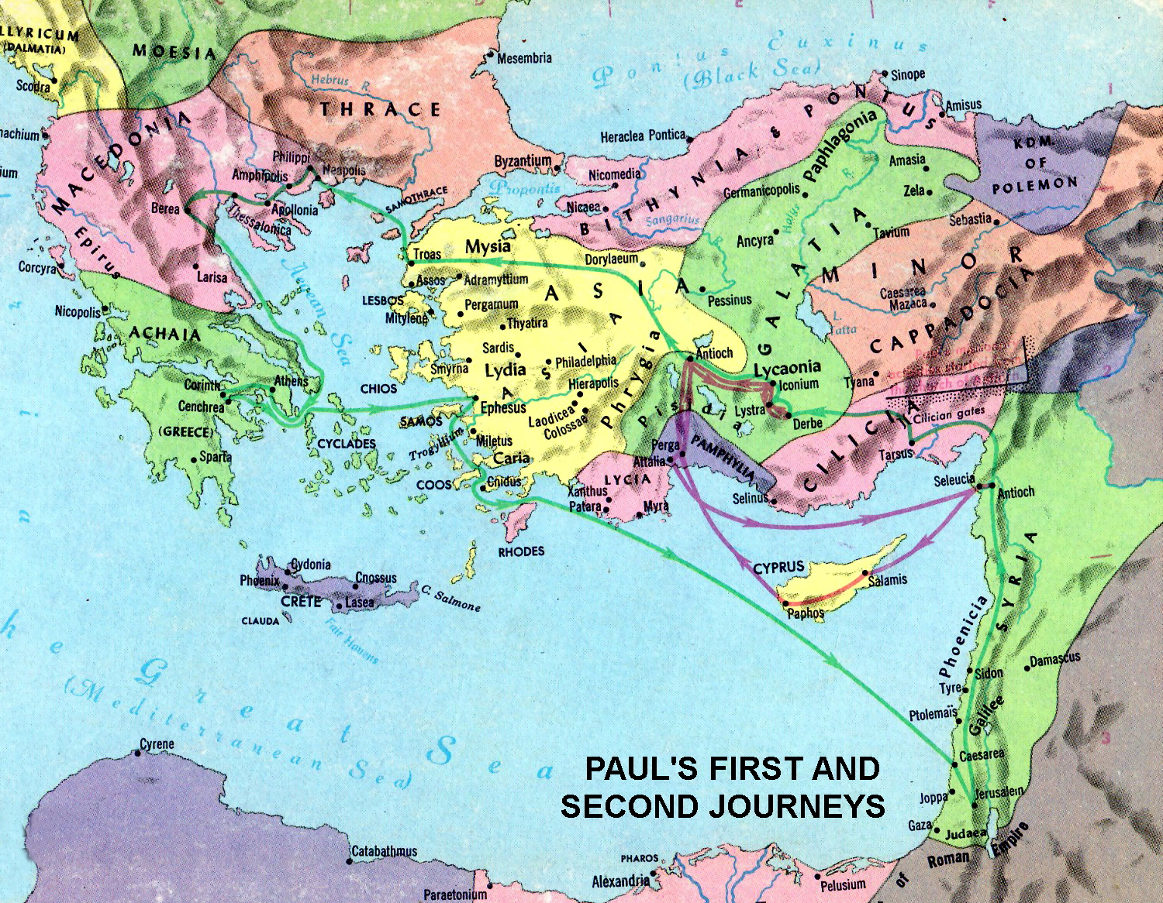
Eastern Mediterranean Area in 50 A.D.

Slide 10
The Date and Place of Writing?
Eight possibilities have been proposed:
At Antioch (Syria), A.D. 48-49, immediately following the first missionary journey and before the Jerusalem Council (Acts 15).
At Antioch (Syria), A.D. 49-50, right after Jerusalem council (Acts 15).
At Corinth, A.D. 52-56 , toward the end of the second missionary journey.
At Antioch (Syria), after the second missionary journey.
At Ephesus, shortly after Paul arrived there on his third missionary journey, or just before he left Ephesus for Macedonia, A.D. 55-57.
From Macedonia on the third journey, A.D. 56-57.
From Corinth on the third journey just before the writings of Romans, A.D. 57-58 A.D.
The possibility (remote) that Galatians was another prison letter from Rome, A.D. 61-63. Robert L. Johnson, The Letter of Paul to the Galatians, The Living Word Commentary, pages 25-26.

Slide 11
Paul's first three Jerusalem trips:
Reference | Purpose of trip | Companions
Acts 9:26-28 | Meet with Peter (for 15 days) | Met by Barnabas in Jerusalem
Acts 11:28-30 & 12:25 | Deliver famine relief to Jerusalem church | With Barnabas (& maybe Titus?)
Acts 15:1-4 | Jerusalem conference on necessity of circumcision | With Barnabas & others (maybe Titus)
Gal 1:18-19 | After 3 yrs, to meet with Peter (also saw James) | (None noted)
Gal 2:1 | After 14 yrs, to communicate the gospel he preached (Gal 2:2,7,9) | With Barnabas & Titus

Slide 12
Option 1 Definition:
Places the 14-year trip of Gal 2:1 as the famine relief trip.
Galatians written from Antioch before second missionary journey begins.
Pros: 1. Paul gets approval of his doctrinal gospel before first missionary journey
2. Paul’s confrontation with Peter (Gal 2:11-14) over eating with Gentiles
occurs before Jerusalem council.
3. Paul writes Galatians before Jerusalem council
Cons: 1. 14-year span of Gal 2:1 must overlap with 3-year span of Gal 1:18
2. Titus is not mentioned in Acts as accompanying Paul & Barnabas
Option 3 Definition:
Places the 14-year trip of Gal 2:1 as the Jerusalem council trip.
Galatians written during second missionary journey (probably from Corinth)
Pros: 1. Issue of circumcision of Titus is related to the Jerusalem council purpose.
2. 14-year span of Gal 2:1 does not have to be consecutive with 3-year span of Gal 1:18.
Cons: 1. Paul doesn’t get approval of his doctrinal gospel until after first missionary journey.
2. Paul’s confrontation with Peter over eating with Gentiles occurs after Jerusalem council.
3. Paul writes Galatians after Jerusalem council & doesn’t even mention it.

Slide 13
Gal 1:11-12 But I make known to you, brethren, that the gospel which was preached by me is not according to man. For I neither received it from man, nor was I taught it, but it came through the revelation of Jesus Christ.
When did Jesus reveal the gospel to Paul?
Some say it was on the road to Damascus, the only time scripture indicates
Jesus directly appeared to Paul.
But that’s not what the scriptures in Acts support.
Acts 9:6 So he (Paul), trembling and astonished, said, "Lord, what do You want me to do?" Then the Lord said to him, "Arise and go into the city, and you will be told what you must do."
Jesus also said:
Acts 26:16 “But rise and stand on your feet; for I have appeared to you for this purpose, to make you a minister and a witness both of the things which you have seen and of the things which I will yet reveal to you.”
Jesus clearly said there would be a revelation sometime in the future.

Slide 14
Gal 1:11-12 But I make known to you, brethren, that the gospel which was preached by me is not according to man. For I neither received it from man, nor was I taught it, but it came through the revelation of Jesus Christ.
Gal 1:16-17 . . . that I might preach Him among the Gentiles, I did not immediately confer with flesh and blood, nor did I go up to Jerusalem to those who were apostles before me; but I went to Arabia, and returned again to Damascus.
TIME
Paul baptized by Ananias
Paul to Jerusalem to see Peter
Acts 9:18
Gal 1:18; Acts 9:26
In Damascus
Visits Arabia
In Damascus
Duration | “several” days (Acts 9:19) | Duration unspecified | “many” days (Acts 9:23)
Activity | Preached in Synagogues that Jesus is Son of God (Acts 9:20) | Activity unspecified | His preaching confounded the Damascus Jews by proving that this Jesus is the Christ. (Acts 9:22)
Reaction | Amazed that this former persecutor was preaching Jesus (Acts 9:21) | Saul increased all the more in strength (Acts 9:22) | the Jews were so unhappy they plotted to kill him (Acts 9:23)
Gal 2:1
3 years?
Gal 1:18
14 years
3 years?
14 years

Slide 15
Who wrote the book (and to whom)?
Gal 1:1-2 Paul, an apostle (not from men nor through man, but through Jesus Christ and God the Father who raised Him from the dead), and all the brethren who are with me, to the churches of Galatia.
“There is no book in the Bible, the authorship of which is more certain than that the apostle Paul wrote to the churches in Galatia. It is so certain from the eternal evidence that Paul is its author that it cannot be called in question (Gal. 1:1). The first two chapters of the letter constitute a rather detailed autobiography of Paul’s life from the time of his conversion to the writing of the letter.
--- Roy Cogdil, The NT - Book By Book, page 67-68.
Audience: Written to the “churches of Galatia” however there are two historical possibilities for the region of Galatia.

Slide 16
Where are we?
Acts records Paul visiting Galatia on all three of his missionary journeys.
1st journey: Acts 13:14, 14:1,6
2nd journey: Acts 16:1-6
3rd journey: Acts 18:23
The reason for the writing of this letter is evident from the contents. The churches in Galatia had begun well (Gal. 5:7), but soon after Paul’s departure, Judaizing teachers had drawn them away to the form of error mentioned in Acts 15:1; that is, "Unless you are circumcised according to the custom of Moses, you cannot be saved.” They sought to impose circumcision as a mandate for gentile conversion to Christianity. The Judaizing teachers had attacked Paul, questioning his apostleship. They thought that they could destroy all confidence folks had in Paul, proving him to be a fake. By doing this they could advance the false doctrine that circumcision was essential for salvation.

Slide 17
Why is Galatians so important?
Paul’s letter speaks wisdom and clarity into the controversy that plagued the church in its early years — the relationship between Christian Jews and Christian Gentiles. Making circumcision mandatory for every Gentile convert was at the core of the legalism that prevailed among Jewish Christians in Galatia. This, of course, was not only false, but it was a fundamental error.
Gal 3:26-28 ²⁶For you are all sons of God through faith in Christ Jesus. ²⁷For as many of you as were baptized into Christ have put on Christ. ²⁸There is neither Jew nor Greek, there is neither slave nor free, there is neither male nor female; for you are all one in Christ Jesus.
Paul’s aggressive tone shows just how important it was to him that the people embrace unity in Christ, no matter their racial distinctions.

Slide 18
Why is Galatians so important?
For Paul, this was no minor issue, as he went so far as to call the Galatians deserters of Christ, people turning from the truth toward a gospel contrary to the one they had received from him.
Gal 1:6-8 ⁶I marvel that you are turning away so soon from Him who called you in the grace of Christ, to a different gospel, ⁷which is not another; but there are some who trouble you and want to pervert the gospel of Christ. ⁸But even if we, or an angel from heaven, preach any other gospel to you than what we have preached to you, let him be accursed.
To that person, Paul says, “Let him be accursed.” The Christian’s walk is to be led by truth; we are to Walk with (by) the Spirit.
Gal 5:25 If we live in the Spirit, let us also walk in the Spirit.
Gal 6:16 And as many as walk according to this rule, peace
and mercy be upon them,

Slide 19
What's the point?
When the Galatians fell away so quickly from the gospel of grace Paul had preached to them, they showed their disloyalty to Paul’s authority as an apostle. Therefore, Paul began the letter to the Galatians by spending two chapters defending that very issue. Only in chapter 3 did he begin to get to the heart of their error; namely, that these Galatians sought to be justified by the Mosaic Law.
The possible motivation of the Judaizers was threefold:
They thought that one had to become a Jew (circumcised) in order to be a Christian (Acts 15:1).
They could not comprehend how a person could follow the Jewish Messiah without becoming a Jew (being circumcised).
They viewed the Law as having a restraining value for Gentile Christians, who had just come out of paganism.
In contrast, Paul presented his argument that justification comes to people by faith in Jesus Christ, not by their works under the Law. The legal approach to keeping the Law had failed and Paul shows the futility in that approach. This is not to infer that grace does not demand obedience.

Slide 20
How do I apply
Unfortunately, the false teaching brought to the Galatian churches by the Judaizers has been extremely difficult to root out even today. We must walk a fine line—on one hand, we do not want to fall into the legalism that the Galatians struggled with, but on the other, we cannot just live as if anything goes. The Christian’s commitment to Christ is based on the free gift of grace through faith, but as Paul articulated at the end of Galatians, it also results in a life of walking by the Spirit.
Is the fruit of the Spirit evident in your life, or do you find yourself living according to the flesh or “the compulsions of selfishness” (Galatians 5:16–26)? Too often we lose ourselves at the extremes, ending in a legalistic attempt to earn our salvation or a devil-may-care attitude about our sin.
Use Paul’s words in Galatians as an encouragement to pursue a life of holiness, not in your own strength but in the knowledge of God’s empowering grace in your life.

Slide 21
A major paradigm shift
“A key to understanding this letter to the Galatians is to remember how the Jews were resentful of the conversion of the Gentiles. Jews had been the special people in covenant relationship with God from the time of Abraham, 2000 years earlier. Circumcision was the sign of that covenant (Gen. 17:9-14). Until Christ, the Jews were to be separate from the Gentiles, not to intermarry nor to go after their idolatrous ways. The first Christians were all Jews (or proselytes), and not until some seven to nine years after Pentecost was the first Gentile converted. Even then, it took a vision from God to instruct Peter to go Cornelius (Acts 10). Therefore in the early church much contention arose whether or not to accept Gentiles.” --- Harkrider, Workbook Commentary Series, Galatians and James, page 1.

Slide 22
Brief Outline
GREETING (1:1-5)
PAUL’S OPPOSITION TO A “DIFFERENT GOSPEL” (1:6-10)
PAUL’S AUTOBIOGRAPHICAL DEFENSE OF THE GOSPEL (1:11-2:21)
A. Paul’s divine call and early ministry (1:11-24)
1. The gospel received by revelation (1:11-12)
2. The gospel’s transforming power - from persecution to preacher (1:13- 17) 3. The gospel that Paul preached not dependent on others (1:18-24)
B. Paul’s meeting with the Jerusalem pillars (2:1-10)
C. Paul’s confrontation with Peter (2:11-21)
PAUL’S DEFENSE OF THE GOSPEL OF CHRIST (3:1-5:1)
A. The Holy Spirit received by faith (3:1-5)
B. Abraham’s righteousness received by faith (3:6-9)
C. The curse of the Law upon the Jews (3:10-14)
D. The promise of Abraham made before the law (circumcision) (3:15-18)
E. The inadequacy of the Law (3:19-22)
F. The temporary nature of the Law (3:23-4:7)
G. Paul’s personal plea (4:8-20)
H. The allegory of Hagar and Sarah (4:21-5:1)

Slide 23
Brief Outline
THE CHRISTIAN WALK (5:2-6:10)
A. Freedom in Christ (5:2-15)
1. The Law versus Christ (5:2-6)
2. The Galatians error (5:7-9)
3. The Apostle’s response (5:10-12)
4. “Called to freedom” (5:13-15)
B. Walking by the Spirit (5:16-26)
1. The Spirit versus the flesh (5:24-25) 2. The “deeds of the flesh” (5:19-21)
3. “The fruit of the Spirit” (5:22-23) 4. The Spirit’s victory over the flesh (5:24-25) 5. The Apostle’s admonition to the church (5:26) C. Bearing one another’s burdens (6:1-10)
CONCLUDING REMARKS (6:11-18)
- - - Duane Warden, Truth for Today Commentary, Galatians

Slide 24
Chapter 1: Paul’s introduction
Gal 1:1-5 Paul opened his letter with a brief greeting to the churches of Galatia. The value of introductions in Paul’s epistles should not be skimmed over. The opening remarks to the Galatian churches touches on the main theme that he intended to address in the rest of the book. Paul sets forth his apostolic authority, the grace and peace of God, and the sacrifice and resurrection of Jesus Christ.
Gal 1:3-4 ³Grace to you and peace from God the Father and our Lord Jesus Christ, ⁴who gave Himself for our sins, that He might deliver us from this present evil age, according to the will of our God and Father,
Gal 1:6-10 He omitted his usual compliments and prayers for them and immediately registered a strong rebuke to those who would proclaim a different gospel from the one he had preached. He boldly asserts that his responsibility is to please God, not men.
Gal 1:11-24 He then begins an extensive defense of his apostleship and of the true gospel directly revealed to him by Christ.
Gal 1:9 . . . if anyone preaches any other gospel to you than what you have received, let him be accursed.
Gal 1:12 For I neither received it from man, nor was I taught it, but it came through the revelation of Jesus Christ.

Slide 25
Chapter 2-3: Justification by Faith, not Law
Although the Galatians had been “called by the grace of Christ” (1:6), some had deserted Christ for a “different” gospel (which is not a gospel at all as it was from men, not God). This “new” gospel came from Judaizing teachers who insisted gentile Christians needed to follow the Law of Moses. Paul would make it clear to them that such actions would mean nothing less than exchanging their salvation in Christ for a legal system by which no person could be saved.
Gal 3:10-12 ¹⁰For as many as are of the works of the law are under the curse; for it is written, "Cursed is everyone who does not continue in all things which are written in the book of the law, to do them. ¹¹But that no one is justified by the law in the sight of God is evident, for "the just shall live by faith.“ ¹²Yet the law is not of faith, but "the man who does them shall live by them.”
Through Christ, we die to the law and live by faith.
Gal 2:19-20 For I through the law died to the law that I might live to God. I have been crucified with Christ; it is no longer I who live, but Christ lives in me; and the life which I now live in the flesh I live by faith in the Son of God, who loved me and gave Himself for me.

Slide 26
Chapter 3-4: Purpose of the Law
The purpose of the Law: To instruct us and bring us to Christ.
Gal 3:23-26 ²³But before faith came, we were kept under guard by the law, kept for the faith which would afterward be revealed. ²⁴Therefore the law was our tutor to bring us to Christ, that we might be justified by faith. ²⁵But after faith has come, we are no longer under a tutor. ²⁶For you are all sons of God through faith in Christ Jesus.
At the right time God sent His son to redeem those under the law and to adopt them into His family.
Gal 4:4-7 ⁴But when the fullness of the time had come, God sent forth His Son, born of a woman, born under the law, ⁵to redeem those who were under the law, that we might receive the adoption as sons. ⁶And because you are sons, God has sent forth the Spirit of His Son into your hearts, crying out, "Abba, Father!“ ⁷Therefore you are no longer a slave but a son, and if a son, then an heir of God through Christ.

Slide 27
Chapter 5: Freedom in Christ
Under Christ we are freed from the Law and should not become so entangled in “legalism” that it overshadows the love that grows from a working faith.
Gal 5:1 Stand fast therefore in the liberty by which Christ has made us free, and do not be entangled again with a yoke of bondage.
Gal 5:6 For in Christ Jesus neither circumcision nor uncircumcision avails anything, but faith working through love.
A working faith creates opportunities for serving one another through love.
Gal 5:13-14 For you, brethren, have been called to liberty; only do not use liberty as an opportunity for the flesh, but through love serve one another. For all the law is fulfilled in one word, even in this: "You shall love your neighbor as yourself."
First century Pharisees allowed legalism to blot out the love they should have had for their brethren. We need to be careful how we use our liberty.

Slide 28
Legalists vs. Liberty
“In Galatians the reader captures the biblical sense of a “legalist” who is opposed to God’s grace. The word “legalist” is sometimes used in a negative way to ridicule a person who insists on having Bible authority for every religious endeavor. This accusation infers that if one insists on obedience to God’s word, he is supposedly guilty of denying that we are saved by God’s grace. This accusation reflects a misunderstanding of the kind of legalism that is condemned in the Bible, and furthermore, it incorrectly infers that salvation by grace nullifies the necessity of obedience. . . Galatians is written to expose the error of Judaizing teachers who were insisting that Gentile Christians be circumcised in keeping with the Law of Moses in order to be saved. Their form of “legalism” was sinful because the Law of Moses had served its purpose and was no longer in force.”
--- Harkrider, Workbook Commentary Series, Galatians and James, Foreword.

Slide 29
Chapter 5: Walking By the Spirit
The Christian walk is to be by the Spirit, not by sight.
Gal 5:16 I say then: Walk in the Spirit, and you shall not fulfill the lust of the flesh.
Works of the flesh: Gal 5:19-21. Being covered on Wednesday nights.
Gal 5: 21b . . . those who practice such things will not inherit the kingdom of God.
Works of the Spirit: Gal 5:22-23. But the fruit of the Spirit is love, joy, peace, longsuffering, kindness, goodness, faithfulness, gentleness, self-control. Against such there is no law.
Installing and amplifying the works of the Spirit in our lives will draw us closer to Christ and to our brethren and will make us pleasing to God.
Gal 5:24-25 And those who are Christ's have crucified the flesh with its passions and desires. If we live in the Spirit, let us also walk in the Spirit.

Slide 30
Chapter 6: Love & Support for Our Brethren
We need to be watchful for any of our brothers & sisters who have been overtaken in a trespass and do what we can, in love, to help them recover. This passage gives practical advice on how to do this, including introspection into our own status.
Gal 6:1-4 ¹Brethren, if a man is overtaken in any trespass, you who are spiritual restore such a one in a spirit of gentleness, considering yourself lest you also be tempted. ²Bear one another's burdens, and so fulfill the law of Christ. ³For if anyone thinks himself to be something, when he is nothing, he deceives himself. ⁴But let each one examine his own work, and then he will have rejoicing in himself alone, and not in another.
Final thoughts: Utilize our opportunities to do good.
Gal 6:9-10 ⁹And let us not grow weary while doing good, for in due season we shall reap if we do not lose heart. ¹⁰Therefore, as we have opportunity, let us do good to all, especially to those who are of the household of faith.

Slide 31
Galatians
55-57
A.D.
Personal Words from Paul
Doctrinal Teaching
Practical Exhortations
“Be not deceived; God is not mocked: for whatsoever a man soweth, that shall
he also reap” 6:7)
Defense of the
True Gospel
Freedom from
Legalism
Freedom to Love
and to Serve
“For I would have you know, brethren,
that the gospel which was preached by
me this is not according to man. For
by me is not according to man. For I
neither received it from man, nor was
I taught it, but I received it through a
revelation of Jesus Christ.” (1:11-12)
“Therefore the Law has be-
come our tutor to lead us to
Christ, so that we may be
justified by faith. But now
that faith has come, we are no longer under a tutor.”
(3:24-25)
“For you were called to
freedom; only do not turn
your freedom into an
opportunity for the flesh.
but through love serve
one another.” (5:13)
Chapters 1-2
Chapters 3-4
Chapter 5-6
Style
Vigorous, blunt, direct and brief…correct Judaizing teachers (see Acts 15:1)
Theme
Justification comes through Christ Jesus, not by works of the Law
“Nevertheless, knowing that man is not justified by the works of the Law but through faith in Christ Jesus, even we have believed in Christ Jesus, so that we may be justified by faith in Christ and not by the works of the Law, since by the works of the Law no flesh will be justified.” (2:16)
Key Verse
Notes:
Galatians has always been among those Pauline epistles least challenged on the issue of authorship. Paul wrote to the churches in southern Galatia after having a hand in starting them on his first missionary journey to Asia Minor. These churches included Antioch of Pisidia, Iconium, Lystra and Derbe (Acts 14:1-28). The letter was written in about A.D. 57, about 12 years after these churches had been established. Paul’s close relationship to these churches helps to explain the extremely strong tone he took with them from the very beginning of the letter. Galatians exhibits Paul at his angriest, ”astonished that you are so quickly deserting him who called you in the grace of Christ and are turning to a different gospel” (1:6). In fact, to emphasize the seriousness of his purpose, he took the pen from his scribe and wrote the end of the letter himself in “large letters” (6:11 leading many to conclude that Paul had impaired vision. Upon arriving back in Antioch from his first missionary journey after eighteen months on the road, Paul received a report that the churches he had started in Galatia had fallen into hard times—specifically, they had fallen into error. Apparently, a group of Judaizers—those who sought to make a living under the Mosaic Law a requirement of the Christian faith—had gained an influence in the Galatian churches. More specifically, they were making circumcision a necessity for all Gentile coverts (5:2-6).. We recall that Paul had earlier been in attendance at the Jerusalem Council where the apostles would take up this very topic (Acts 15:1–30). It was not new. Paul had clearly taught the Galatians that “as many as were baptized into Christ” had been made “sons of God” --- be it Jew or Greek, male or female (3:26-27). How could it be that they so soon had forgotten his instruction? Paul’s rebuke is straightforward (1:6-8). The theme is clearly justification by faith in Christ Jesus (3:26-29). No one can keep the Law perfectly. That said, we must walk a fine line—on one hand, we do not want to fall into the legalism that the Galatians struggled with, but on the other hand, we cannot just live as if anything goes. Obedience matters. The Christian’s commitment to Christ is based on the free gift of grace through faith, but as Paul articulated at the end of Galatians, it also results in a life of walking by the Spirit (Gal. 16:1ff.). Paul reminds us, “Be not deceived; God is not mocked: for whatsoever a man soweth, that shall he also reap” (6:7). The letter can be divided into three parts: Paul is an apostle through Jesus Christ and not after man (chs. 1-2); justification is by faith in Christ Jesus and not by the words of the Law of Moses (chs. 3-4); exhortations to steadfastness and faithfulness to all Christians (chs. 5-6).
Application
Preachers beware! Preaching is not intended to please men: “For am I now seeking the approval of man, or of God?” (1:10)
Error must be exposed immediately: “But when Cephas came to Antioch, I opposed him to his face” (2:11).
Peter feared the wrong thing: “but when they came he drew back and separated himself (from Gentiles), fearing the circumcision party” (2:12b). We must not make men bigger than God.
The Law serves as a tutor (schoolmaster) to bring us unto Christ - its purpose was to show the need of a Savior (3:23-25).
The Spirit is in us when we walk by the Spirit (5:25); The flesh and the Spirit are contrary to one another.
Key thought: The word “Fruit” is singular. The character of godliness includes all the characteristics of the fruit of the Spirit. As darkness is the opposite of light, so are the works of the flesh the opposite of the works of the Spirit. It is a demonstration of character.

Slide 32
Both Luke (in Acts) and Paul (in Galatians) wrote about
events of Paul's early activity as a Christian.
Acts 9:6 & 22:10 – Christ said: "Arise and enter Damascus and you will be told what you must do."
Acts 26:16 – Christ also said to Paul: "you will be a witness to things in which I will yet reveal to you."
Acts 9:17-18 – Encounter with Ananias and subsequent baptism.
Acts 9:20 – His desire to preach Jesus as the Son of God was immediate.
Acts 9:19 – He was with the disciples in Damascus for "several" days.
Gal 1:11-12 – Paul says his message came directly though the revelation of Jesus Christ.
Gal 1:16-17 – Paul did not consult with any man but went to Arabia and returned again to Damascus. (The time spent in Arabia is unknown.)
Acts 9:22 – His preaching in Damascus was dynamic, "confounding" the Jews and proving that Jesus is the Christ (the Jewish Messiah).
Acts 9:23-24 – When "many" days had elapsed, his preaching became so intolerable for the Jews that they sought to kill him.
Acts 9:25, 2 Cor 11:32-33 – He escaped from the Jews over the city wall.
Acts 9:26-28, Gal 1:18 – After 3 years, he made his first trip to Jerusalem to meet with Peter.

